Slide 1
Progress report
Speaker: Geng-Yun Tien
Advisor: Eric Y. Chuang
Date: 2023/10/20

Slide 2
Works
1
Recheck TCGA patches and do quality control
2
Retrain CNN models for patch-level prediction
3
AACR abstract (finish 300 words)
Other works
1
TA works & homework

Slide 3
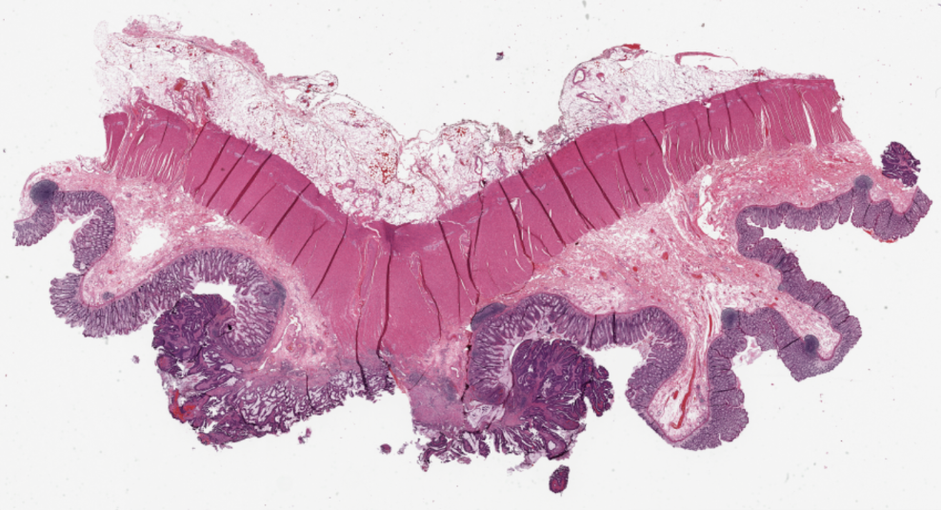
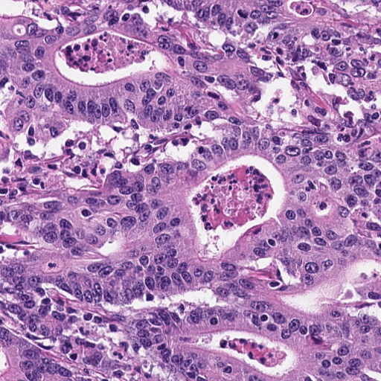
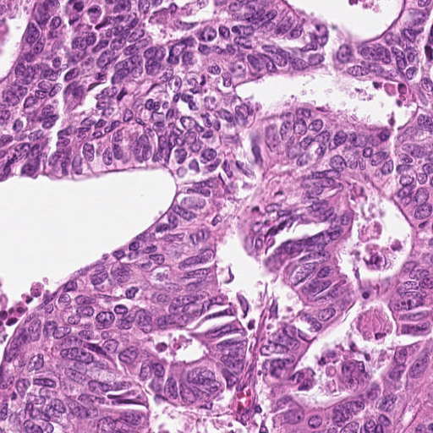
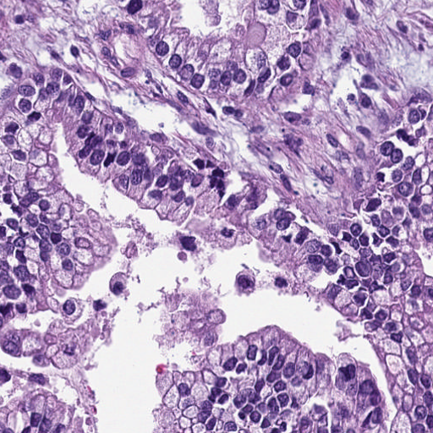
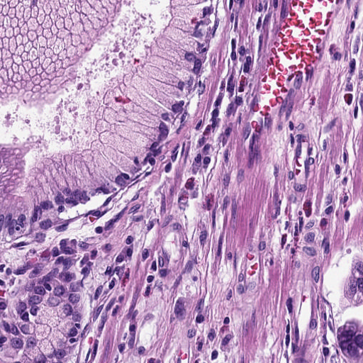
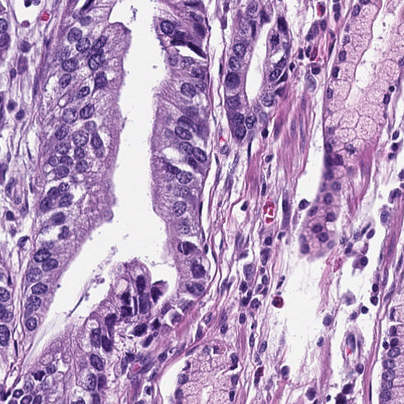
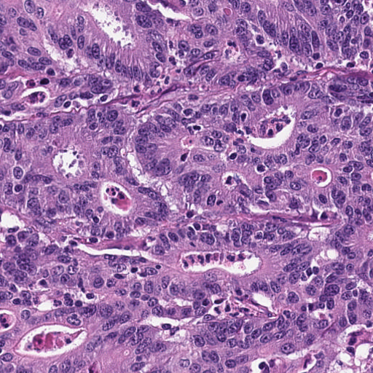
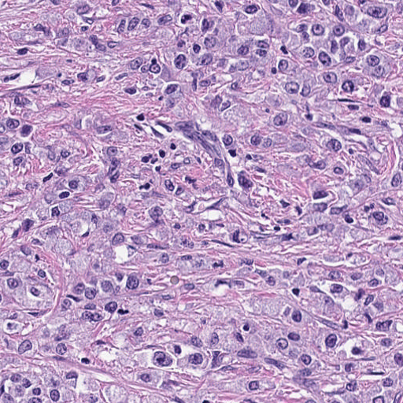
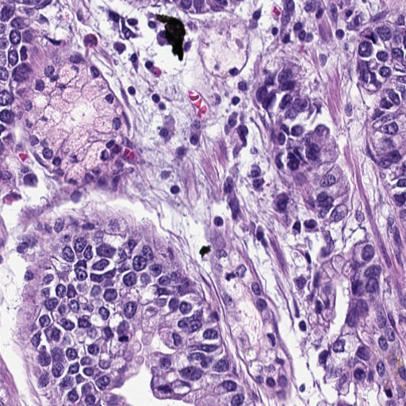
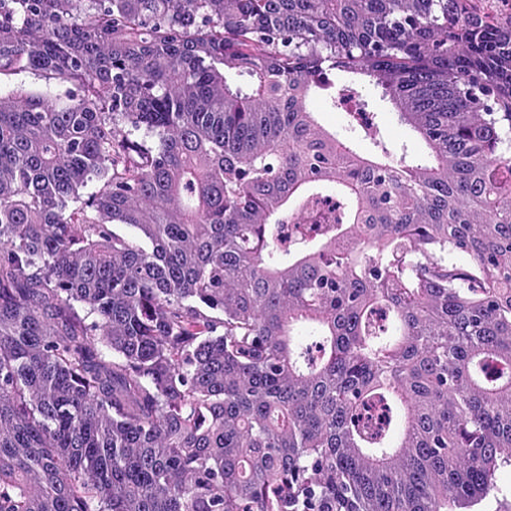
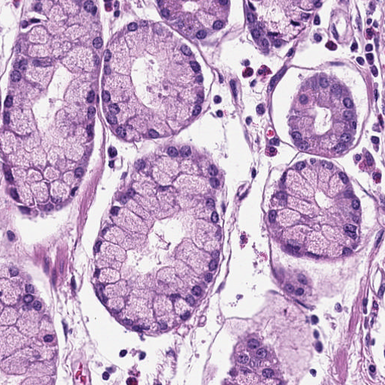
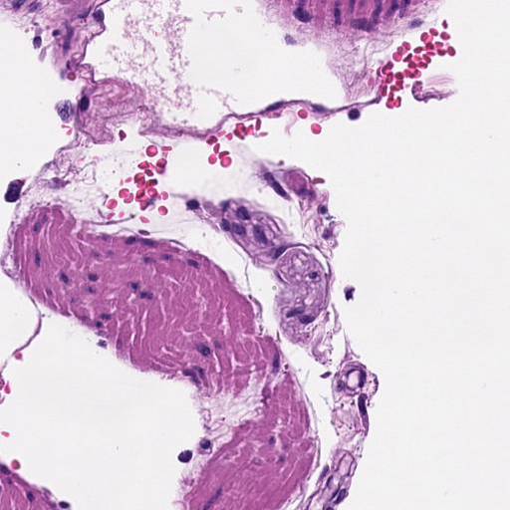
a. Image preprocessing
b. Classified adenocarcinoma epithelium patches
c. KRAS gene mutation prediction
TCGA WSI with KRAS mutation label
TCGA tumor patches
NCT training dataset with tissue type label
NCT testing dataset with tissue type label
Training
Testing
Prediction model
KRAS mutation
or
KRAS wildtype
Classification model
Trained model inference
TCGA patches without tissue type label

Slide 4
KRAS gene mutation prediction – CNN model
a. CNN model predict patch-level outcome
TCGA classified tumor patches
output dim
Input
Output
CNN model
n
……
n
b. Aggregate patch-level outcome to slide-level prediction
c. Train multiple CNN model to do ensemble learning
output dim
Model 1
Average
output dim
Model 2
output dim
n
Standard deviation
Ensemble
……
Model 3

Slide 5
Research title
1
Integrated deep learning pipeline for predicting gene mutation using histopathology images in colon and rectum adenocarcinoma
2
Prediction of gene mutation from colon and rectum adenocarcinoma whole slide images via integrated deep learning pipeline
3
Gene mutation prediction based on whole slide images in colon and rectum adenocarcinoma using integrated deep learning pipeline

Slide 6
Future work
1
Finish AACR abstract
2
Aggregate into slide-level prediction for individual CNN model
3
Try to predict another gene

Slide 7
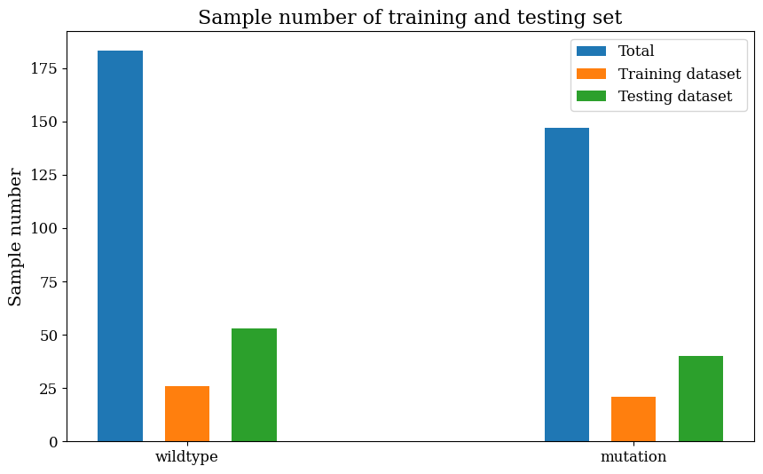
WSIs data processing
The training, validation and testing dataset of each class is composed of 70%, 10% and 20% combination of TCGA-COAD and TCGA-READ
 | Training dataset | Validation dataset | Testing dataset | Total
KRAS wildtype | 183 | 26 | 53 | 262
KRAS mutation | 147 | 21 | 40 | 208
Total | 330 | 47 | 93 | 470

